Slide 1
Dietary: a Cloud-based Nutriment & Fitness Assistant
(fact-based) Android App for Bangladeshi Youths.
CSE 299 Presentation on Progress Week - 05
Presenting By : Group 1
Date : 20.08.2020

Slide 2

Agenda
Previous works
Weekly Update
Upcoming Plan
Conclusion
Q/A Segment

Slide 3

Previous Works
Authentication using Firebase
Fitness Assistant for ‘Busy life’

Slide 4
Weekly Update
User Interface
Dataset
User Assistant

Slide 5
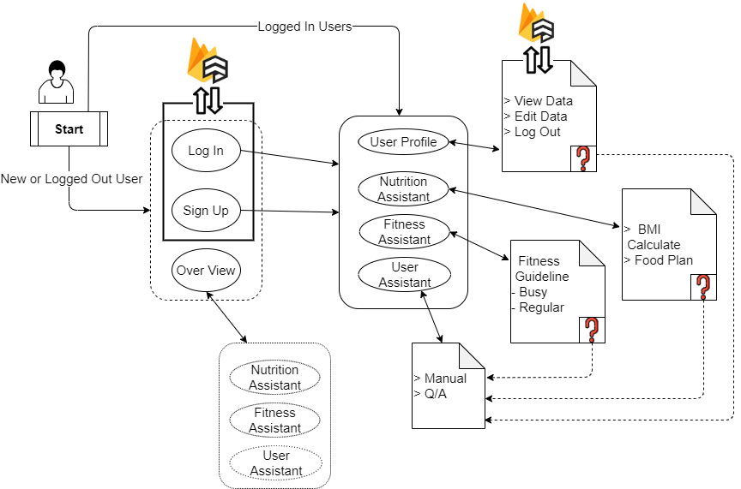
Prototype of User Experience

Slide 6
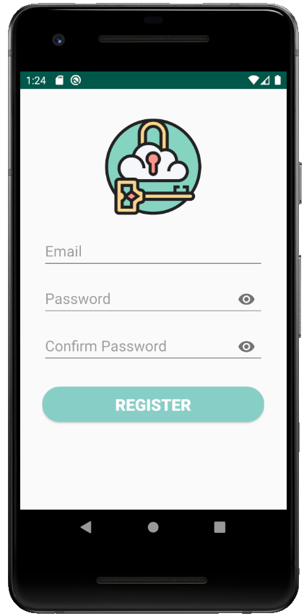
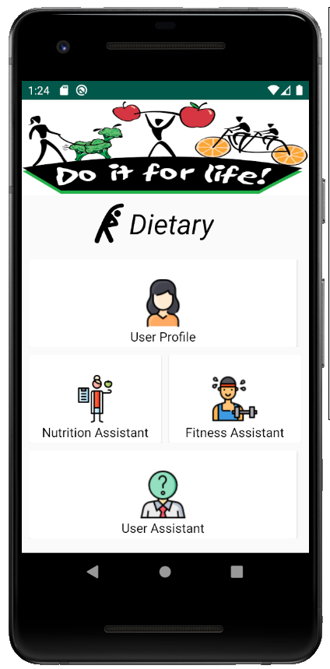
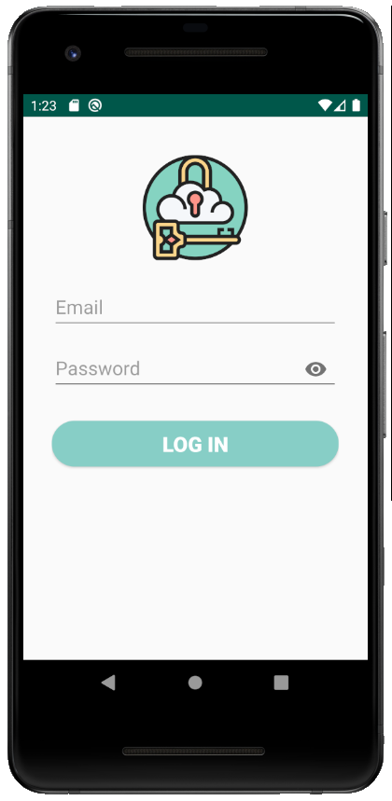
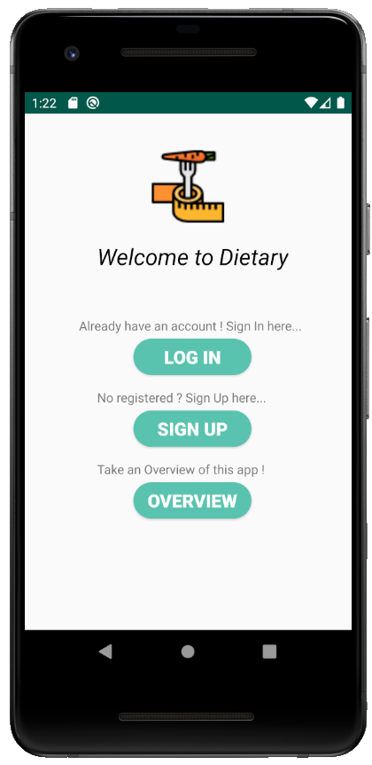
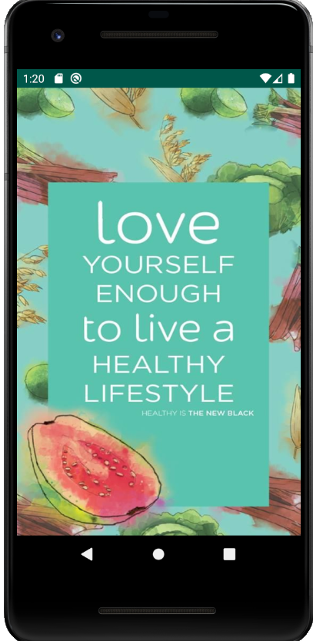
User Interface

Slide 7
User Interface

Slide 8
User Interface
On Progress
On Progress
On Progress
On Progress

Slide 9
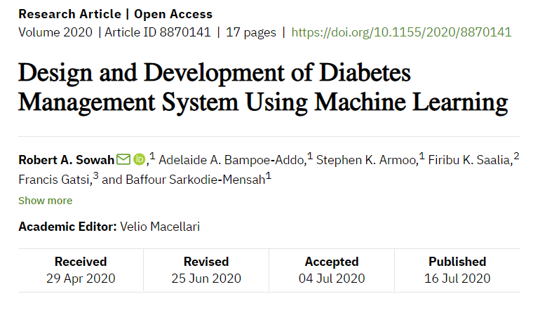
Dataset
Expected Dataset :
Dataset provided by :
Adjetey Robert Sowah
Adelaide Bampoe Addo

Slide 10
User Assistant
Due to some issue this task will be present on upcoming presentation

Slide 11
Upcoming Plan
Nutrition Assistant
Fitness Assistant
User Assistant

Slide 12
Conclusion
In this week we mainly focused on User Interface (UI).
Because,
The UI design of a mobile application includes the look and feel of the app; this means how an application interacts with its users. It generally emphasizes on the presentation of the app.

Slide 14
Any
Questions
Or
Suggestion !

